Slide 1



_{Ready Analysis:}
_{Final Results for}
_{VERTEX}
_{May 18}^{th}_{, 2007}
Hendel Valverde – Consultant
Juan Fernando Pena – Project Manager
Roberto Leiton – Director, Professional Services

Slide 2
Agenda
Project Goals
Migration Scope
Application Overview
Migration Requirements and Solutions
Migration Recommendation
Project Estimate
Discussions & Next Steps

Slide 3
Migration Project Methodology
* Time line is not to scale
100% Functional
Equivalence
Maximum
Benefits
From .NET
Output from
Conversion
Tool
Current
Application
Incremental Changes
Automatic
Conversion
Process
Manual
Changes &
Testing
Customized Evolution
Evaluation
Process
“READY”
Re-engineering and New Functionality
Artinsoft Consulting Services

Slide 4
Project Goals
Achieve Functional Equivalence
Ensure future evolution in .NET
Guarantee strategic evolution for customers
Obtain Microsoft Support
Accomplish unification of shared code
Take advantage of .NET features

Slide 5
General Migration Scope
Omiga Application
  Client
  Core

Slide 6
VERTEX applications overview (1)
Lines of Code per Priority Group
Overall Migration Project Size
Group | Visual Lines | Code Lines | Comment Lines | Blank Lines | Effective Lines of Code
Client | 0 | 456,261 | 108,905 | 167,638 | 456,261
Core | 300 | 160,580 | 45,053 | 18,305 | 160,880
Total | 300 | 616,841 | 153,958 | 185,943 | 617,141

Slide 7
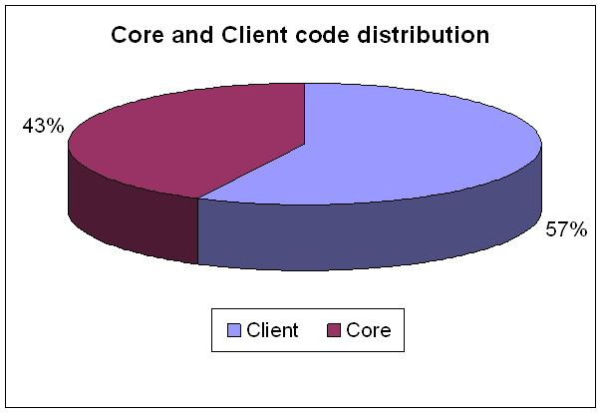
VERTEX applications overview (2)
Lines of Code per Priority Group

Slide 8
Migration Requirements
Database Access Conversion to ADO.NET
Replacement of other COM controls and components, when possible
MSXML to System.Xml
Change the VB6 namespace functions to native .NET functions
Use of static classes instead of Modules
Error handling conversion modifications

Slide 9
Items to be addressed from VB6
Remove Unstructured Error Handling
  On Error Resume
  On Error GoTo
Execute CodeAdvisor

Slide 10
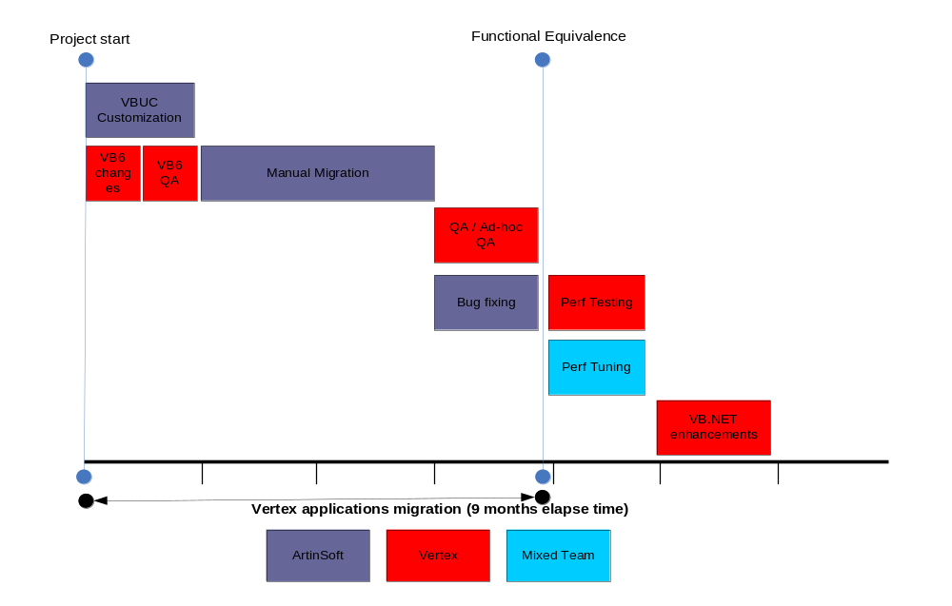
Proposed Project Structure for Option 1

Slide 11
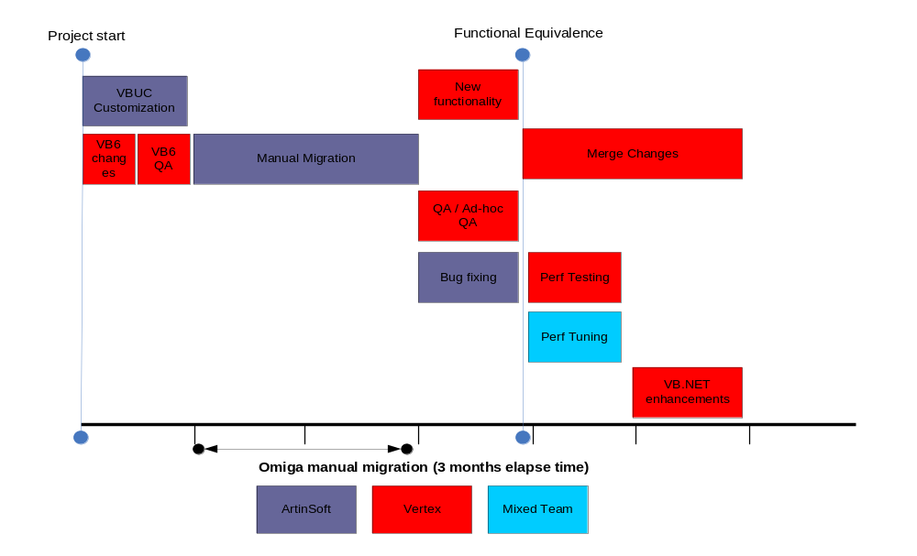
Proposed Project Structure for Option 2

Slide 12
Main activities description
VB6 / QA
  VB6 code modifications and Quality Assurance
Migration
  VB6 to C# code conversion

Slide 13
Main activities description
QA
  VERTEX will test the migrated application, using the previously generated set of test cases for core functionality
Ad-hoc QA
  Application end-user testing, limited by time and coverage
Bug Fixing
  Bugs found by the QA team are fixed by ArtinSoft during this activity

Slide 14
Main activities description
Performance Testing
  A series of tests will be prepared to measure the performance of the now Functionally Equivalent application
Performance Tuning
  Code modifications will be done to achieve the desired performance level
C# Changes
  VERTEX will continue to improve the migrated application before releasing it

Slide 15
Project costs
Requirement | Price
Add COM Support | $3,847.00
COM+ and Transactions | $7,695.00
Interfaces | $2,308.00
AssemblyInfo.cs | $3,463.00
Porting Main Procedure | $770.00
Porting the App Object | $1,539.00
Rewrite Late Binding to COM Classes | $1,539.00
Incorrect Porting of VB Function Return (delete objXmlDoc = null) | $192.00
Replace MSXML (map parseError to try..catch(XmlException) | $192.00
Stored Procedure Parameters | $770.00
Replace Microsoft.VisualBasic (Map Information.IsNumeric) | $385.00
Remove VSA Support | $770.00
Dispose and Using | $2,309.00
Cannot implicitly convert type 'uint' to 'int'. An explicit conversion exists (are you missing a cast?) | $95.00
'CompareMethod' is an ambiguous reference between 'Microsoft.VisualBasic.CompareMethod' and 'Scripting.CompareMethod'” Manual Changes | $770.00
cmd.Execute , , adExecuteStream. Argument '1': cannot convert from '<null>' to 'out object' | $385.00
The variable 'variable' is assigned but its value is never used | $770.00
Total | $27,798.00

Slide 16
Project costs
Migration Plan | Migration Plan 1 | Migration Plan 2
VBUC License | $89,999.00 | $89,999.00
VBUC Customization | $27,798.00 | $27,798.00
Migration Project | $492,056.00 | $590,121.00
Total | $598,800.00 | $699,900.00

Slide 17
Open items for discussions
Next Steps….
- Option
- Decision process
- Schedule
- Start date
- Paperwork process

Slide 18
Thank You

